Slide 1
The Funnels
The Funnels

Slide 2
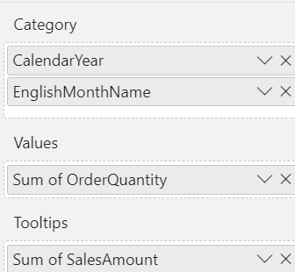
The Funnels
This lab is using AdventureWorks2016DW data base
Add the Funnel visualization to the scene and configure the parameter values as shown in the table
Setting | Field(s)
Category | CalendarYear
 | EnglishMonthName
Values | OrderQuantity
Tootips | SalesAmount

Slide 3
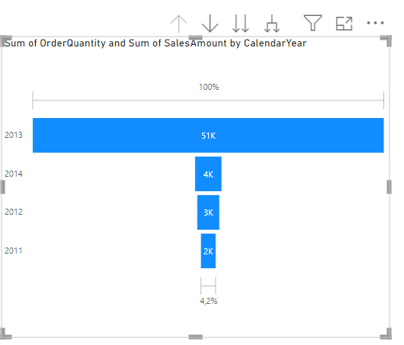
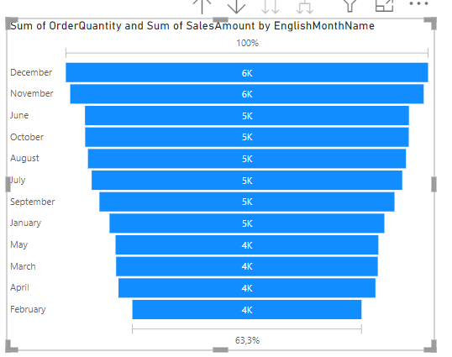
The Funnels
Observe the Funnel and try to perform Drillthrough operations provided by the menu at the top right

Slide 4
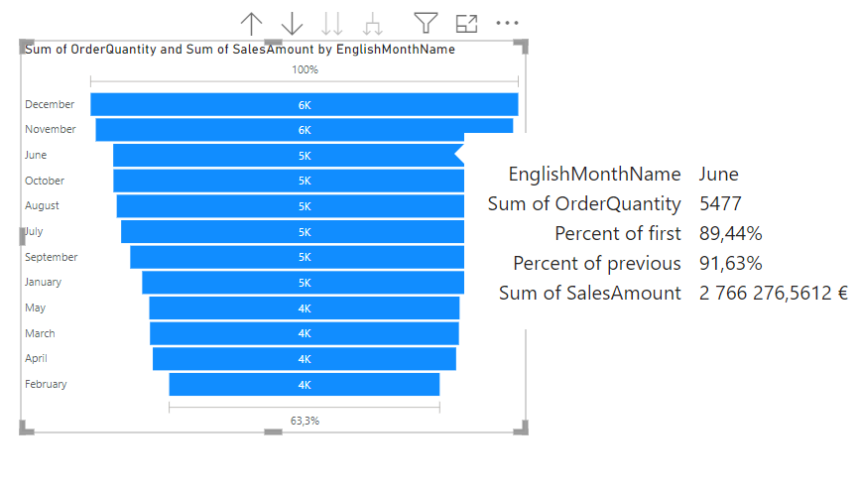
The Funnels
Try hovering over one of the histograms

Slide 5
Thank you
Thank you

